Slide 1
Assembly Language Programming

Slide 2
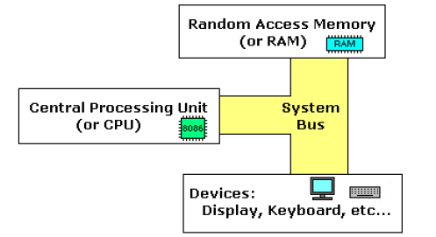
Simple Computer Model

Slide 3
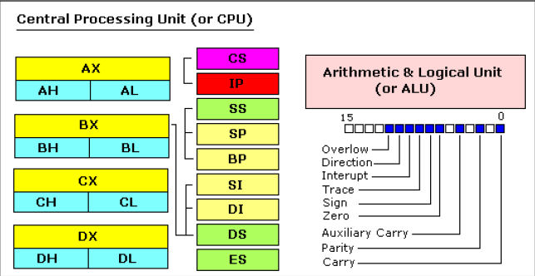
Inside the CPU

Slide 4
CPU Registers
Segment registers: Four 16-bit registers
General purpose registers: Eight 16-bit registers
  Data Registers
  Pointer and Index Registers
Instruction Pointer
Flags register
Special purpose registers
  Debug registers
  Machine Control registers

Slide 5
Segment Registers
Code Segment, CS – points at the segment containing the current program
Data Segment, DS – generally points at the segment where variables are defined
Extra Segment, ES – extra segment register, up to coder (you)
Stack Segment, SS – points at the segment containing the stack

Slide 6
Data Registers
AX | Arithmetic & Logical operation, Data transfer, Integer Function return values * One operand must be in AX or AL in Multiplication and Division
BX | General
CX | Loop counter values
DX | High 16 bits of a 32 bit value

Slide 7
Pointer and Index Registers
SI | Source address (in DS) for memory moves / compare instructions
DI | Destination address for memory moves / compare instructions
SP | Stack pointer (for SS)
BP | Base frame pointer (used to access function parameters, local variables)

Slide 8
Register accesses
IA32 supports accessing portions of the CPU registers: EAX, EBX, ECX and EDX through special mnemonics.
EAX | Full 32 bit access
AX | 16 bit access (bits 15:0)
AH | High byte access (15:8)
AL | Low byte access (7:0)

Slide 9
The EFLAGS Register
Contains the status and control flags that are set by the instructions executed. These indicate the result of the instruction execution.

Slide 10
The FLAGS Register flags
Flag | Intel Mnemonic | Notes
Overflow | OF
Direction | DF | Indicates the direction of string processing. 1 means highest address to lowest. 0 means lowest address to highest address
Interrupt Enable | IF | Set to 1 if interrupts are enabled. This is always set to 1 by a user mode debugger
Sign | SF
Zero | ZF
Auxiliary Carry | AF | Indicates a carry/borrow in BCD arithmetic
Parity | PF
Carry | CF

Slide 11
Sample Code
Program Listing PGM1_1.ASM
TITLE PGM1_1: SAMPLE PROGRAM
.MODEL SMALL
.STACK 100H
.DATA
A DW 2
B DW 5
SUM DW ?
.CODE
MAIN PROC
; initialize DS
MOV AX, @DATA
MOVE DS, AX
; Add the numbers
MOV AX, A
ADD AX, B
MOV SUM, AX
; exit to DOS
MOV AX, 4C00H
INT 21H
MAIN ENDP
END MAIN

Slide 12
Instruction Format
General format:
  [prefix] instruction operands
Prefix used only in String Functions
Operands represent the direction of operands
  Single operand instruction: XXX src
  Two operand instruction :XXX dest src
    XXX represents the instruction opcode
    src & dest represent the source and destination operands respectively

Slide 13
Instruction Format (cont’d)
Source operands can be:
  Register/Memory reference/Immediate value
Destination operands can be:
  Register/Memory reference
Note:
  The Intel CPU does NOT allow both source and destination operands to be memory references

Slide 14
Memory References
Same as a C/C++ pointer access
Pointer operands appear within square brackets e.g.
  MOV AX, [0x0222h]
  Can also have register names instead of hex addresses e.g. MOV AX, [BX]
Contents of memory location 0x0222
Refers to the contents of register BX

Slide 15
Memory References (cont’d)
Control the size of memory accessed by preceding the memory reference with a size:
  BYTE PTR: byte access
  WORD PTR two byte access
  DWORD PTR four byte access
  E.g. MOV EAX, BYTE PTR [0x00001234]

Slide 16
Memory References (cont’d)
Invalid Memory Accesses
  Accessing illegal memory: CPU generates a general protection fault: (GPF)
  Access a memory location that does not exist: CPU generates a page fault

Slide 17
The x86 Stack
Starts from high memory and “grows” towards low memory
Used by the CPU to:
  Store return addresses
  Pass parameters to functions
  Store local variables
SP indicates current top of stack

Slide 18
x86 Assembly Instructions
“Instructions You Need to Know”
-John Robbins

Slide 19
NOP
NOP – No operation
  Takes no arguments
  Commonly used by the compiler as padding INSIDE functions so as keep them properly aligned

Slide 20
Stack Manipulation Instructions
PUSH <argument>
  Pushes a word/double word on the stack
  argument can be a register/memory location/immediate value (hard coded number)
POP <argument>
  Pop a word/double word from the stack
Note:
  PUSH decrements the SP while POP increments the SP

Slide 21
Stack Manipulation Instructions (cont’d)
PUSHA
  Push (save) all general purpose registers
POPA
  Pop (restore) all general purpose registers
Avoids long sequence of PUSH/POP instructions to save/restore the registers
  Used mainly in system code

Slide 22
Arithmetic Instructions
ADD <dest> <src>
SUB <dest> <src>
The result is stored in the destination and the original value in destination is overwritten.

Slide 23
Arithmetic Instructions (cont’d)
DIV/MUL: Unsigned Division/Multiplication
  Uses the EDX register to store the high bytes of double-word and higher (64 bit) results. EAX stores the low bytes
IDIV/IMUL: Signed Division/Multiplication
  IMUL sometimes has 3 operands:
    IMUL <dest> <src1> <src2>

Slide 24
CPU Breakpoint Instruction
INT 3 (OxCC)
  Mainly used as padding by compilers as padding BETWEEN functions in a file
  Keeps portable executable sections aligned on the linker’s /ALIGN switch (defaults to 4 KB)
  Allows for misaligned memory accesses to be easily detected
    Executing this instruction stops CPU execution and automatically invokes the debugger

Slide 25
Pointer Manipulation Instructions
LEA: Load Effective Address
  LEA <dest> <src>
  Loads the destination register with the address of the source operand
  Used to emulate pointer access

Slide 26
Function Call Instruction
CALL <argument>
  argument can be a register \ memory reference \ parameter \ global offset
  Automatically pushes the return address on the stack and decrements ESP

Slide 27
Function Return Instruction
RET <optional argument>
  Argument says how many bytes to pop off the stack (to account for parameters passed to the function)
  Pops the callers return address off the top of stack and put it in the instruction pointer
    Return address validity is NOT checked!!!: potential security hazard

Slide 28
Data Manipulation Instructions
AND <dest> <src> : logical AND
OR <dest> <src> : logical OR
NOT <arg>: logical NOT
  One’s complement negation (Bit Flipping)
NEG <arg>:
  Two’s complement negation

Slide 29
Data Manipulation Instructions (cont’d)
XOR <dest> <src>: logical XOR
  Fastest way to zero out a register!!!
INC/DEC <arg> : increment/decrement
  Often used in speed optimized code (executes in single clock cycle)
  Directly maps to the C++ operators:
    ++ : INC
    -- : DEC

Slide 30
Data Manipulation Instructions (cont’d)
SHL/SHR <arg> : shift left and Shift right
  SHL: fastest way to multiply by 2 (C++: <<)
  SHR: fastest way to divide by 2 (C++: >>)

Slide 31
Compare Instruction
CMP <arg1> <arg2>: compare arg1 and arg2 and set the appropriate conditional flags in the FLAGS register

Slide 32
Test Instruction
TEST <arg1> <arg2> : Bitwise AND of both arguments and sets the appropriate conditional flags
  SF
  ZF
  PF

Slide 33
Jump Instructions
JE <label> : Jump if equal
JL <label> : Jump if less than
JG <label> : Jump if greater than
JNE <label> : Jump if not equal to
JGE <label> : Jump if greater than or equal to
JLE <label> : Jump if Less than or equal to

Slide 34
Jump Instructions (Cont’d)
Always follow a CMP/TEST instruction
JMP condition is always the opposite of the original conditional

Slide 35
Loop Instruction
Loop <label>: Decrement CX and if CX isn’t 0, go and re-execute the code sequence marked by <label>

